Slide 1



Software Analyzer
Rabriele Daniels

Slide 2
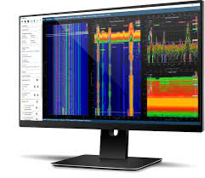
What is this?
This will be software that can find code related to what a consumer is searching for and will also check for any malicious files and deal with those accordingly. This software will help people not only be able to research to find answers but will also act as an internal security mechanism that can analyze and stop malware from corrupting the integrity of the consumer’s device.

